Slide 1
Nehushtan
Numbers 21:4-9; 2 Kings 18:1-4

Slide 2
Brazen Serpent
Text – Numbers 21:4-9
People complain (verses 4-5)
God sent fiery serpents among them (verse 6)
The people cry out and repent (verse 7)
Moses makes a serpent of brass; all who look on it are saved (verses 8-9)

Slide 3
Nehushtan
Text – 2 Kings 18:1-4
The brazen serpent was kept in Jerusalem (verse 4)
The Israelites burned incense to it (verse 4)
It was called Nehushtan
“a thing of brass”; a name by which the brazen serpent was worshipped in the days of Hezekiah (Brown-Driver-Briggs)
Hezekiah’s first reforms involved destroying it

Slide 4
The Lesson of Nehushtan
At one time the brazen serpent held great significance
After the events of the fiery serpents, the brazen serpent was not significant
Israel later attached a significance to it which God did not!
Today man does the same thing!

Slide 5
Tithing
What is it? A tenth
Maasrah - “tenth part, tithe: – tenth (4), tenth part (1), tithe (17), tithes (9), tithing (1)” (New American Standard Hebrew-Aramaic and Greek Dictionaries)
It was a tenth of your income or increase

Slide 6
Tithing
Practiced in the OT
Patriarchal Period – Abraham paid a tenth to Melchizedek (Genesis 14:18-20; Hebrews 7:2)
Mosaic Period – Israelites commanded to tithe (Deuteronomy 12:1-7)

Slide 7
Tithing
The purpose for it?
It belonged to the Lord (Leviticus 27:30)
Supported the priesthood (Numbers 18:21-32)
Every third year tithes given to many (Deuteronomy 26:12)
– Levite, sojourner, fatherless, widow

Slide 8
Tithing
In practice today
Denominations practice tithing
“Tithing plate”
What does the gospel teach?
Giving (1 Corinthians 16:1-2)
From the heart (2 Corinthians 9:6-7)

Slide 9
Tithing
Conclusion?
Nowhere does the gospel direct us to give a specific amount or percentage.
If our heart is right, giving will not be a problem.
To bind tithing today is, in principle, to make something significant that is no longer significant!

Slide 10
Temple Worship
What was the Temple? A place of worship
What was its purpose?
God would dwell there (1 Kings 8:10-13; 9:1-3)
God was not confined to it (1 Kings 8:27)
Prayer (Matthew 21:12-13)
Sacrifice (2 Chronicles 7:12)
Holiness (Hebrews 9:1-3)

Slide 11
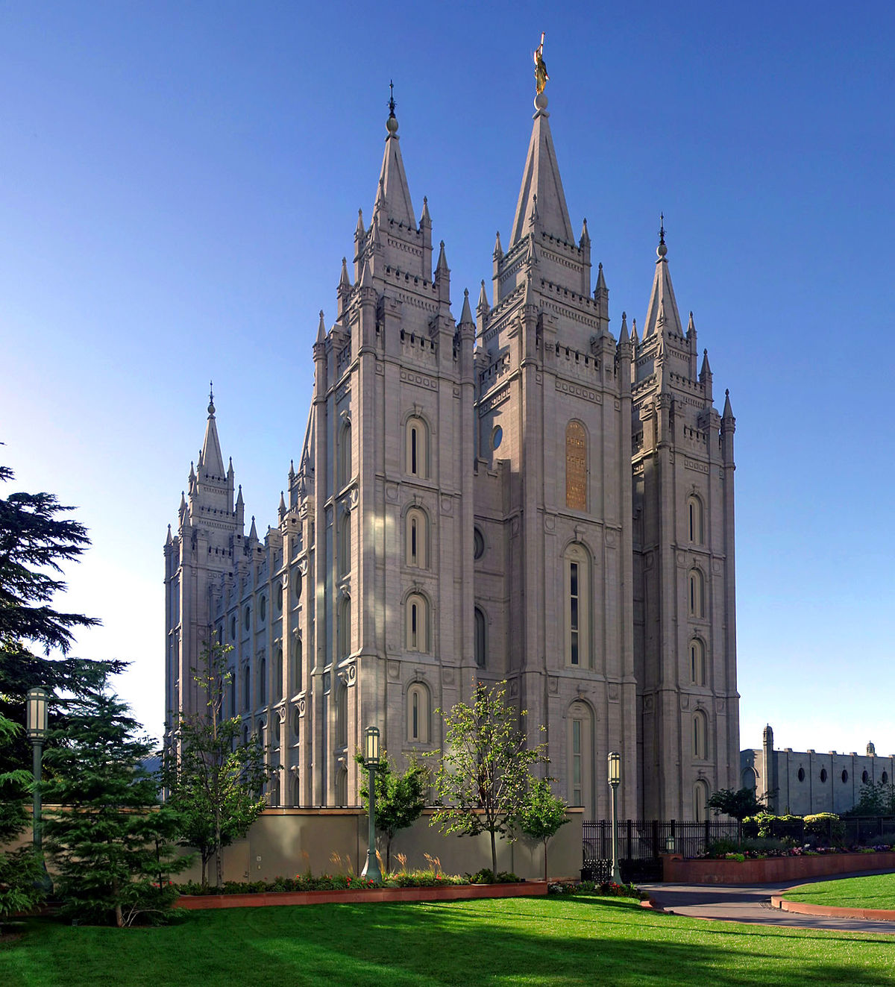
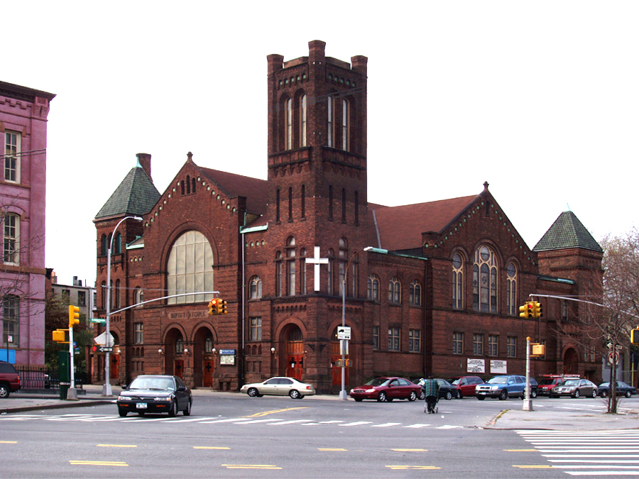
Temple Worship
Temple worship today?

Slide 12
Temple Worship
What does the NT teach?
God does not dwell in the physical (Acts 17:22-25)
The church is the temple of God today
(Hebrews 3:3-6)
We worship in spirit and truth (John 4:21-24)
The NT does not place any emphasis on luxury or architectural appreciation!

Slide 13
Circumcision
What was it? Circumcision in the flesh
Given to Abraham (Genesis 17:9-14)
Grafted into the Mosaic Law
(Leviticus 12:3)
What was its purpose?
A token or sign of the covenant
(Genesis 17:11)

Slide 14
Circumcision
A problem for the NT church
Men from Judea attempted to bind it at Antioch (Acts 15:1, 5)
Men attempted to bind it in Galatia (Galatians 5:6; 6:15-16)
Apostles clearly refuted this idea
(Acts 15:24)

Slide 15
Circumcision
What about today?
Neither one matters (Galatians 5:6)
For reasons of family tradition, health/cleanliness is appropriate; it cannot be bound as a condition of salvation!
They were attempting to make circumcision significant (Ephesians 2:14-15)

Slide 16
The Opposite of Nehushtan
If we learn the lesson of Nehushtan, there is another problem, related to and similar to the issue of binding things no longer significant.
Many today take what God has bound and attempt to minimize or eliminate them all together!
This is just as wrong!

Slide 17
The Church
What is it?
Ekklesia – “a gathering of citizens called out from their homes into some public place, an assembly” – Thayer
Called out of darkness by the gospel
(2 Thessalonians 2:14; 1 Peter 2:9-10)
We are called out of the world into the light; the assembly of God

Slide 18
The Church
Why is it significant?
Christ died for it (Acts 20:28)
Christ purchased it with His blood (Acts 20:28)
All spiritual blessings are found in it
(Ephesians 1:3ff)
Every spiritual blessing in heavenly places
Foreordained, adopted, redemption, forgiveness

Slide 19
The Church
What is its purpose?
Separates us from the world (1 Peter 2:9-10)
A new purpose in life (Ecclesiastes 12:13-14)
Many today attempt to minimize it
Cheapen it, treating it as a secular club
Even teach you do not need to be a member of it
Salvation and church membership are linked!

Slide 20
Baptism
What is it?
Baptizo – “1) to dip repeatedly; immerse; submerge. 2) to cleanse by dipping or submerging.” – Thayer
NT baptism is a dipping, immersion, or plunging of a sinner into the waters of baptism to reach the blood of Christ in His death.

Slide 21
Baptism
What is its purpose?
Saves us (Mark 16:15-16)
Gives remission of sins (Acts 2:38)
Wash away our sins (Acts 22:16)
To add us, one-by-one, to His church (Acts 2:47)
Bring us into Christ (Romans 6:1-4)
Walk in newness of life (Romans 6:4)

Slide 22
Baptism
Many today deny its significance
Change the practice – Infant baptism, sprinkling, and pouring
For denominational membership
Outward sign of an inward faith
The ultimate end – Sinners are robbed of their salvation!

Slide 23
Faithfulness
What does it mean to be faithful?
“Trusty, faithful a) of persons who show themselves faithful in the transaction of business, the execution of commands, or the discharge of faithful duties” – Thayer
Obey His commands (Galatians 5:16-18, 22-24)
Deny sin (Galatians 5:19-21)

Slide 24
Faithfulness
What is its purpose?
To achieve a crown (Revelation 2:10)
To be fit for the kingdom of God (Luke 9:57-62)
To encourage and build up our brethren (Hebrews 10:24-25)

Slide 25
Faithfulness
Many attempt to diminish or eliminate it
Once saved, always saved
Security of the believer
Cannot sin so as to be lost
This deceit causes souls to be lost. Faithfulness cannot be minimized!

Slide 26
Conclusion
Nehushtan teaches a powerful lesson
The OT scriptures lay important groundwork and principles (Romans 15:4)
We cannot bind things which are no longer significant
We cannot diminish or eliminate things God has deemed important in the NT
We must handle the scripture rightly
(2 Timothy 3:15)

Slide 27
Obey the Gospel
Not a Christian? Become one today!
Hear (Romans 10:17)
– “So belief cometh of hearing, and hearing by the word of Christ.”
Believe (Hebrews 11:6; John 3:16)
– “And without faith it is impossible to be well-pleasing unto him; for he that cometh to God must believe that He is, and that He is a rewarder of them that seek after Him.”

Slide 28
Obey the Gospel
Repent (Luke 13:3)
– “I tell you, Nay: but, except you repent ye shall all in like manner perish.”
Confess (Romans 10:10)
– “for with the heart man believeth unto righteousness; and with the mouth confession is made unto salvation.”

Slide 29
Obey the Gospel
Be Baptized (Mark 16:16)
– “He that believeth and is baptized shall be saved; he that disbelieveth shall be condemned.”
You cannot minimize or diminish this process!

Slide 30
Obey the Gospel
Have you fallen? Fix it!
Repent (Acts 8:22ff)
Confess to God in prayer, asking for forgiveness (1 John 1:6-8)
You cannot minimize or eliminate this process!

